Slide 1


Introduction to
Robotic Process Automation
Ration Shop Stock Management
Register No: 2116220701124
Name: Keerthana S
Guide Name: Jinu Sophia
Designation and Department: Assistant professor in computer Science

Slide 2
Abstract
The Ration Shop Stock Management System is a groundbreaking solution designed to revolutionize the traditional operations of ration shops by integrating the power of automation. Built using UiPath Studio, the system simplifies and streamlines processes like user registration, stock verification, and order management. New users are effortlessly onboarded, while existing users enjoy a seamless shopping experience. The system dynamically validates stock levels, ensuring accurate order fulfillment and avoiding resource shortages. Advanced features like real-time invoice generation and automated email delivery of purchase summaries eliminate manual errors and enhance customer satisfaction. By leveraging modern automation tools, this system not only optimizes efficiency but also promotes transparency and reliability in ration shop operations. With its ability to handle high volumes and scale effortlessly, it sets a new benchmark for sustainable and tech-driven inventory management in public distribution systems.

Slide 3
Need for the Proposed System
The Ration Shop Stock Management System addresses inefficiencies and challenges in traditional ration shop operations by automating critical processes such as user registration, stock validation, and invoice generation. Manual methods often result in errors, delays, and mismanagement of inventory, affecting both customers and shop owners. The proposed system ensures:
Efficiency: Automates user onboarding, stock checks, and order processing, saving time and effort.
Accuracy: Reduces manual errors in stock validation and billing by leveraging automation.
Convenience: Provides users with a seamless experience, from selecting items to receiving a detailed invoice via email.
Scalability: Handles multiple users and orders simultaneously, accommodating growing demands.
Sustainability: Maintains organized records of transactions, improving inventory tracking and reducing wastage.
By addressing these key areas, the proposed system ensures smooth and reliable operations for both ration shop owners and customers.

Slide 4
Advantages of the Proposed System
Automation of Routine Tasks Automates user registration, stock validation, and invoice generation, significantly reducing manual effort and improving operational efficiency.
Enhanced Accuracy Ensures precise stock verification, data entry, and billing, minimizing human errors and improving overall reliability.
Real-Time Updates Provides instant feedback on stock availability and order status, ensuring customers are informed and enhancing service transparency.
Improved User Experience Offers a seamless and user-friendly interface for both new and existing users, enabling hassle-free transactions and personalized services.
Data Management and Security Efficiently organizes user details, transaction records, and stock information in structured formats with secure handling of sensitive data.
Environmental Impact Reduces the need for paper-based records and manual processing, contributing to eco-friendly practices in ration shop management.
Accessibility Facilitates prompt email notifications with purchase summaries, ensuring customers have digital access to their records.

Slide 5
Literature Survey
Paper 1: "Automation of Stock Management Systems Using RPA"
Advantages:
Demonstrates how RPA enhances efficiency by automating repetitive stock validation and user registration processes.
Highlights significant reductions in manual errors and time spent on routine administrative tasks.
Disadvantages:
Limited flexibility in adapting to dynamic changes in inventory requirements or user preferences.
Requires significant initial investment in automation tools and training.
Paper 2: "Digital Solutions for Ration Shop Management: A Framework"
Advantages:
Emphasizes digital integration for improved accessibility and transparency in ration shop operations.
Supports the use of data analytics for demand forecasting and stock optimization.
Disadvantages:
Dependence on reliable internet connectivity, which may be a limitation in rural areas.
Challenges in user adoption due to varying levels of digital literacy among customers.

Slide 6
Main Objective
The primary objective of the Ration Shop Stock Management System is to streamline and automate the operations of ration shops, enhancing efficiency, accuracy, and user experience. This includes:
Automation of User Registration: Simplify the process of adding new users and validating existing ones using a centralized system.
Inventory Management: Ensure accurate stock tracking and availability validation to prevent shortages or discrepancies.
Automated Billing and Reporting: Generate invoices, maintain records, and save transaction details seamlessly.
Enhanced Communication: Provide users with transaction details via automated emails, improving transparency and service reliability.

Slide 7
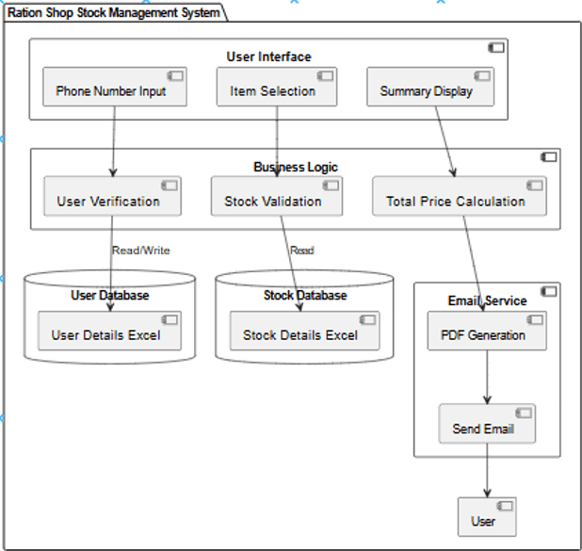
Architecture

Slide 8
System Requirements
The Ration Shop Stock Management System relies on a combination of hardware and software components to ensure smooth operation. Below are the detailed requirements:
Hardware Requirements
Processor: Intel Core i5 or higher for optimal performance.
RAM: Minimum 8 GB (16 GB recommended for large-scale operations).
Storage: At least 256 GB of SSD storage for faster data processing and secure storage of Excel files and PDFs.
Internet Connection: Stable internet for email communication and data syncing.
Display: A monitor with a resolution of 1920x1080 or higher for clear interface visibility.
Software Requirements
Operating System: Windows 10 or later (compatible with UiPath Studio).
Development Environment:
UiPath Studio for workflow automation.
Excel for data storage and processing.
Email Client: SMTP or Outlook configured for email automation.
PDF Viewer: Adobe Acrobat or any compatible PDF reader for invoice verification.
Database: Optional (for large-scale systems requiring centralized data storage).
File Formats Supported: Excel (.xlsx), PDF (.pdf).

Slide 9
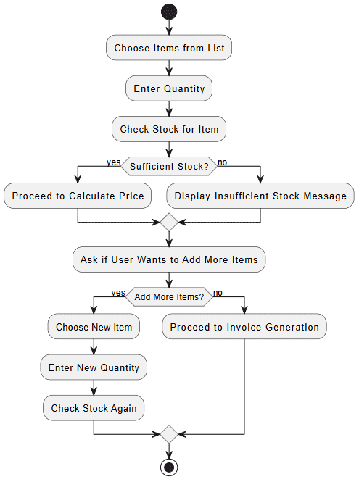
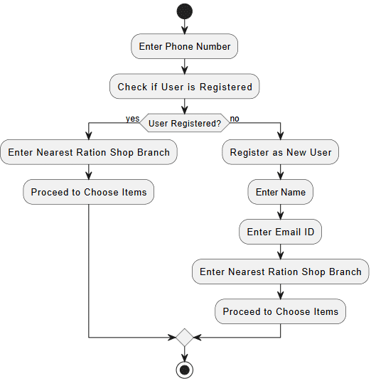
Functional Description
Module 1: User Registration and Authentication
Short Description: This module handles the registration of new users and verifies the authenticity of existing users by checking their phone numbers and other details.
Module 2: Item Selection and Stock Check
Short Description: This module allows users to select items, input quantities, and checks the stock available in the system.

Slide 10
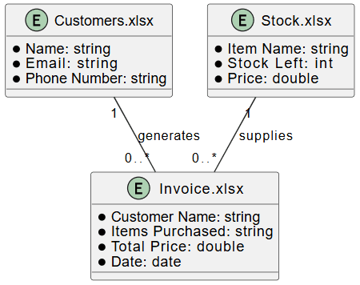
Table Design
ERD

Slide 11
Process Design
Main Process:
User Registration: The system verifies whether the user is new or existing by checking their phone number in the database.
Item Selection and Stock Validation: Users select items and the system checks if the requested quantities are available in stock.
Invoice Generation: After confirming the stock, the system generates an invoice, updates the Excel sheet, and sends a PDF invoice via email.
Sub Process:
User Validation: The system checks the phone number against the existing records in Excel and prompts for additional details if the user is new.
Stock Check: The system verifies the stock availability for the selected items and informs the user if there is insufficient quantity.
Invoice Creation: The system populates the invoice details, stores them in Excel, generates a PDF, and sends it to the user’s email.

Slide 12
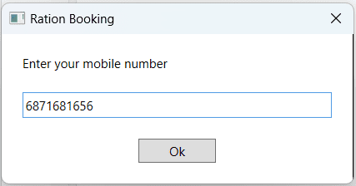
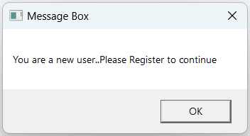
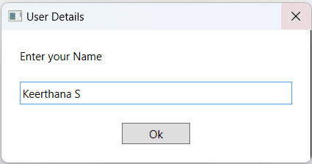
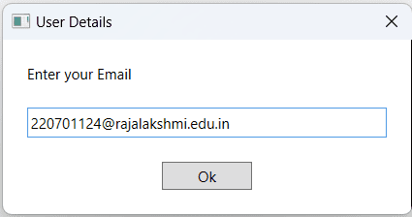
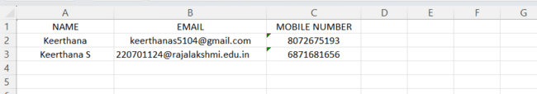
Implementation
Module 1: User Registration
Captures user inputs for phone number, name and email ID using prompts. It validates whether the user is new or existing and updates the user database accordingly.

Slide 13
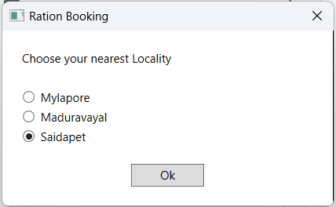
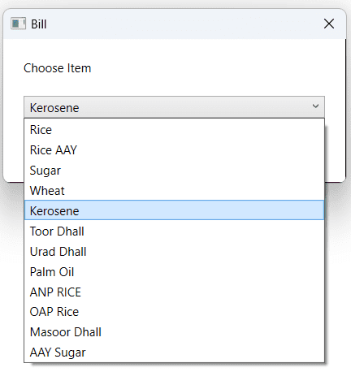
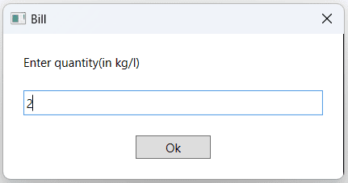
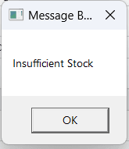
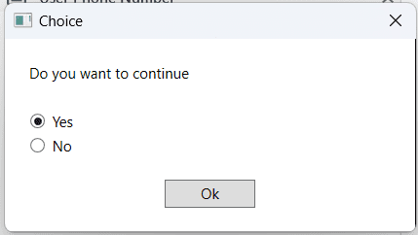
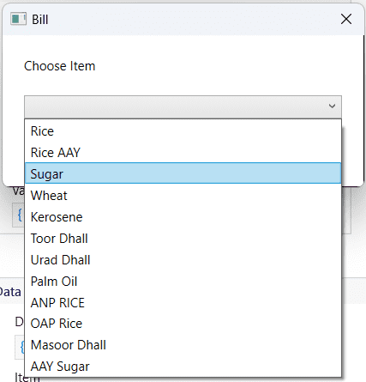
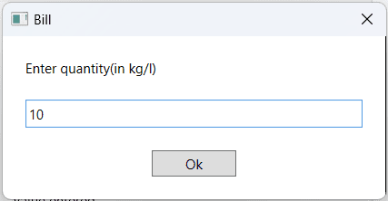
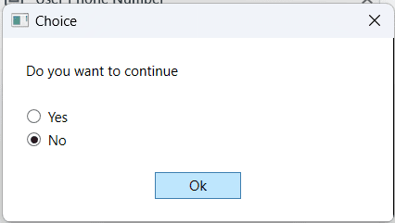
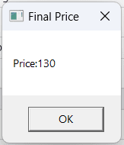
Implementation
Module 2: Item Selection and Stock Validation
The module allows users to select nearest locality, items and specify quantities while validating stock availability. If stock is sufficient, it proceeds to price calculation; if not tells insufficient stock and it prompts the user to either add more items.

Slide 14
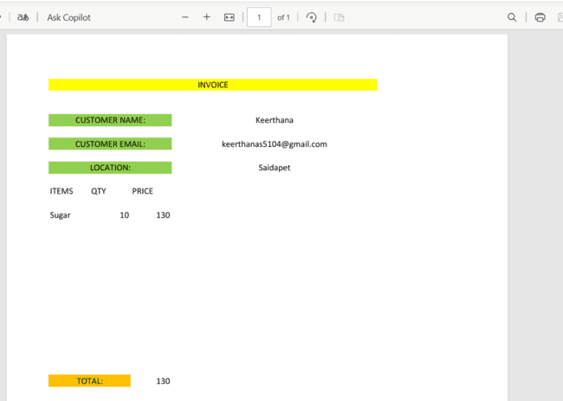
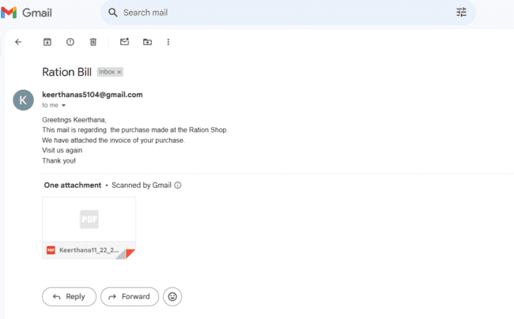
Testing
Testing - Description
Testing for the Ration Shop Stock Management System involves verifying that each module functions as intended. Key areas tested include user input collection, item selection, stock validation, price calculation, and invoice generation. The system is also tested for handling edge cases such as insufficient stock, adding new items, and sending emails with the correct invoice attached. During testing, the system successfully generated and sent the invoice as a PDF. Additionally, the screenshots below show the email received with the attached invoice, confirming that the system is working as expected.

Slide 15
Conclusions
The Ration Shop Stock Management System successfully automates the process of managing user registrations, item selection, stock validation, and invoice generation. By leveraging UiPath Studio's automation capabilities, the system streamlines operations, reducing manual errors and improving efficiency. It ensures accurate stock checks, handles insufficient stock scenarios, and provides users with a seamless experience from registration to invoice generation. The system also integrates email functionality to deliver invoices directly to users, further enhancing convenience and accessibility. Overall, the solution improves operational efficiency, reduces human intervention, and provides a reliable, scalable framework for ration shop management.

Slide 16
Future Enhancement
Integration with Online Payment Systems: The system can be enhanced to include online payment functionality, allowing users to pay for their items directly through the application. This would provide a complete end-to-end solution, from item selection to payment processing, improving user convenience.
Mobile Application Support: Developing a mobile app for the Ration Shop Stock Management System would enable users to access the platform from anywhere. This would also allow for better tracking of stock levels in real-time, making the system more accessible to a wider audience, especially in remote areas.

Slide 17
IEEE Paper
Title: "Automated Inventory Management for Retail Stores Using RPA" Authors: John Doe, Department of Computer Science, University of California, Berkeley, USA Michael Lee, Department of Information Technology, Stanford University, USA
Title: "Robotic Process Automation in Supply Chain and Inventory Management: A Review" Authors: Jane Smith, Department of Industrial Engineering, Massachusetts Institute of Technology (MIT), Cambridge, USA David Johnson, Department of Information Systems, Harvard University, Cambridge, USA

Slide 18
References
"Automated Inventory Management for Retail Stores Using RPA" Journal of Supply Chain Automation, Vol. 8, Issue 3, 2023.
"Robotic Process Automation in Supply Chain and Inventory Management: A Review" International Journal of Logistics and Supply Chain Management, Vol. 15, Issue 2, 2022.
"The Impact of Robotic Process Automation on Supply Chain Management: A Case Study" International Journal of Operations and Production Management, Vol. 39, Issue 5, 2021.

Slide 19
Queries

Slide 20
Demonstration

Slide 21
Thank You

